Slide 1
Software Engineering :
6 : Design : Software Modeling UML - Part 2
Professor Imed Bouchrika National School of Artificial Intelligence imed.bouchrika@ensia.edu.dz

Slide 2
Outline :
Unified Modeling Language
LAB To-do App
UML Revision:
Use Case vs. State vs. Sequence vs. Activity
Structural Diagrams
Class Diagram
UML Tools
Frameworks :
1 - Laravel

Slide 3
UML - Unified Modelling Language
From Requirements to Design and Modelling:
Functional Modelling
Use Case Diagram
Behavioral Modelling
State, Activity, Sequence …
Structural Modeling
Class Diagram, Object, component, package, deployment

Slide 4
UML - Unified Modelling Language
UML is a general purpose notation that is used to
Visualize
Specify
construct and
Document the artifacts of :
Software-based systems
Business and similar processes,

Slide 5
LAB : T0 Do App
Software Process Model :
Using Scrum ?
Using Plan-Driven Methodologies :
Waterfall ?
Spiral ?
…

Slide 6
LAB : T0 Do App
Software Process Model :
Using Scrum ?
Using Plan-Driven Methodologies :
Waterfall ?
Spiral ?
…
Build and Fix Model

Slide 7
LAB : T0 Do App
Is the Software Requirement Specification important ?
It is extremely important to avoid non-feasible or expensive changes to the system in the future.
Implementing the signup features, it was too expensive to add to an existing system
Upgrading the database to include a new table.
Changing the business logic to most functionalities to make sure that only user can edit/delete/view their items..
Changing the interaction flow.
Dealing with old data
….

Slide 8
LAB : T0 Do App
Aim of the To-do App.
Give an overview of how to develop a simple web application without using a framework
A brief introduction to Web Technologies
Get an insight into the architecture of web applications.

Slide 9
LAB : T0 Do App
New Features to consider :
Assigning to-do item to a Category ?
Assigning to-do item to many labels ?
Assigning to-do item to another person to complete it ?
Making sure that users have a valid and verifiable email address ?

Slide 10
LAB : T0 Do App
Terminology :
View
Controller
Model
Decoupling
Upgrading and maintenance
Collaboration

Slide 11
LAB : T0 Do App
Features :
Improve the signup feature to include a process to validate email addresses in addition to verify that the user actually owns the email address provided. Technically, the system would send a secure and custom link to the user to click on it to verify and confirm the status of their account.
Design :
How to better visualize this idea
Which view to to use:

Slide 12
LAB : T0 Do App
Use Case Diagram
State Diagram :
Activity Diagram :
Sequence Diagram :

Slide 13
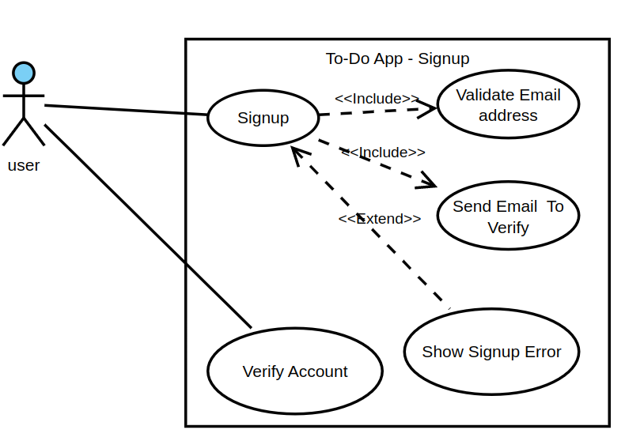
LAB : T0 Do App
Use Case Diagram
State Diagram :
Activity Diagram :
Sequence Diagram :

Slide 14
LAB : T0 Do App
Use Case Diagram
State Diagram : What the are the possible states for the user ?
Activity Diagram :
Sequence Diagram :

Slide 15
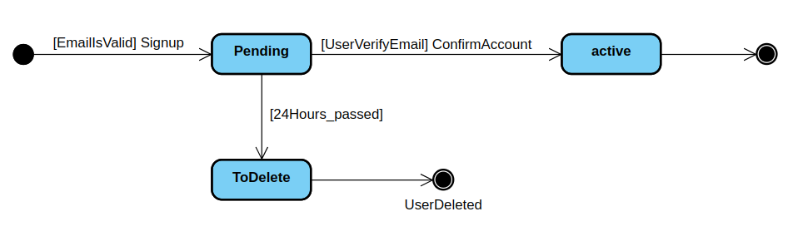
LAB : T0 Do App
Use Case Diagram
State Diagram : What the are the possible states for the user ?
Activity Diagram :
Sequence Diagram :

Slide 16
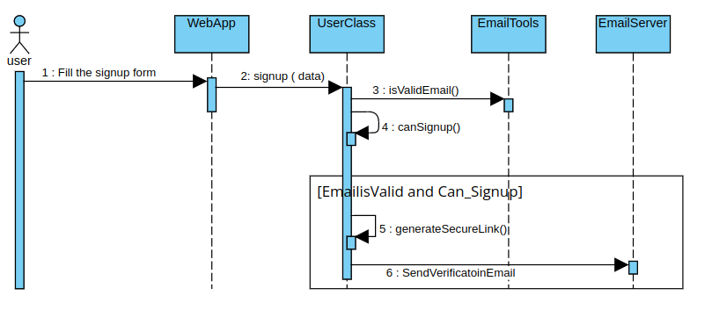
LAB : T0 Do App
Use Case Diagram
State Diagram
Activity Diagram :
Sequence Diagram :

Slide 17
UML - Structural Diagrams - Class Diagram
What’s the Class Diagram
It is a static structural UML diagram to depict the different entities (i.e. classes ) used to construct a software system in addition to details related to their attributes, operations and their relationships.
Entities designed with the class diagrams are :
Classes
Interfaces
Structs

Slide 18
UML - Structural Diagrams - Class Diagram
The use of Class Diagram :
Conceptual modeling
Detailed Structural Modeling
Data Modeling
Programming Code

Slide 19
UML - Structural Diagrams - Class Diagram
Elements of the Class Diagram
Boxes:
Classes with Attributes and Operations
Relationships:
Association
Generalization/Inheritance
Composition/Aggregation
Dependence

Slide 20
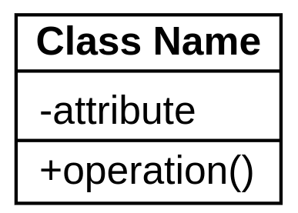
UML - Structural Diagrams - Class Diagram
Drawing the Class Diagram : Classes
A class is drawn as a box with three section:
Top Section : Class name
Middle Section : Attributes
Bottom Section : Operations

Slide 21
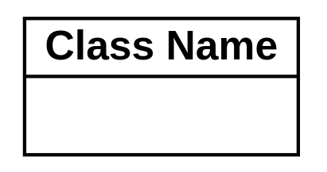
UML - Structural Diagrams - Class Diagram
Drawing the Class Diagram : Classes
For conceptual design without details, the class box can be drawn with only two sections.

Slide 22
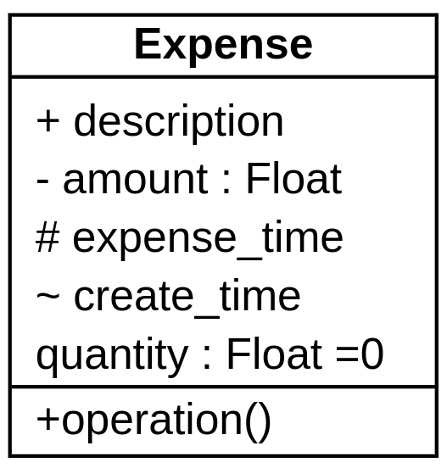
UML - Structural Diagrams - Class Diagram
Class Box : Attributes
The attributes are the adjectives and properties of a given entity.
In programming language : Instance Variables
Within the attributes section, we can specify :
Visibility Scope.
Type of the attribute :
Default value
If to generate the code from the model, you need to use the data types consistent with the target programming language.

Slide 23
UML - Structural Diagrams - Class Diagram
Class Box : Attributes
The attributes are the adjectives and properties of a given entity.
In programming language : Instance Variables
Within the attributes section, we can specify :
Visibility Scope.
Type of the attribute :
Default value
If to generate the code from the model, you need to use the data types consistent with the target programming language.
What about other member attributes like :
Expense Category ?
Created by ?

Slide 24
UML - Structural Diagrams - Class Diagram
Class Box : Attributes
The attributes are the adjectives and properties of a given entity.
In programming language : Instance Variables
Within the attributes section, we can specify :
Visibility Scope.
Type of the attribute :
Default value
If to generate the code from the model, you need to use the data types consistent with the target programming language.
Recommendation : Keep the attributes for variables of basic/primitive data types.

Slide 25
UML - Structural Diagrams - Class Diagram
Class Box : Attributes
Visibility Scope : relates to the level of information hiding to be enforced when accessing the attribute
+ : Public : it can be access from anywhere.
# : Protected : Accessible to subclasses only.
- : Private : Not accessible except from the class only
~ : Package : Accessible from classes of the same package.
Default ( no symbol ) usually : private

Slide 26
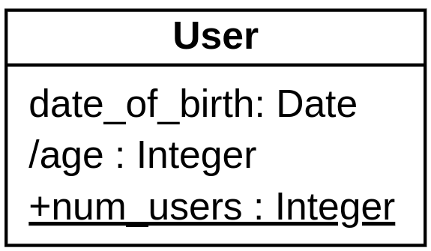
UML - Structural Diagrams - Class Diagram
Class Box : Attributes
Static attributes or global variables that belong to the class and shared between all objects of the same class, are represented by an underline.
num_users
For constant variables, conventionally, the variable name is written in capital letters.

Slide 27
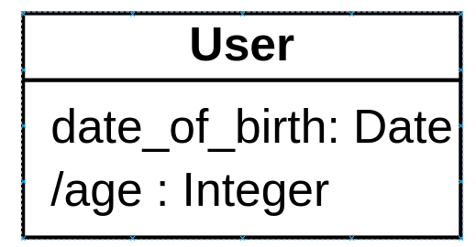
UML - Structural Diagrams - Class Diagram
Class Box : Attributes
Attributes can be non-stored and computed during their time of retrieval.
Example : Age of the person.
To indicate that an attribute is computed and non-stored, the symbol / is used just before the attribute name.

Slide 28
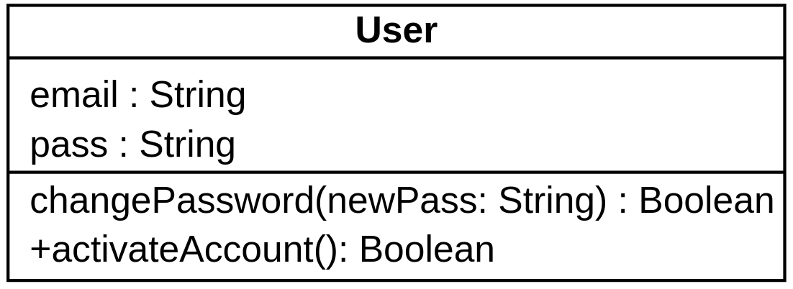
UML - Structural Diagrams - Class Diagram
Class Box : Operations and Methods
Are action, functions or operations that can be performed by a given class.
Class Operation can be specified by :
Visibility modifier
Operation name
Passed Parameters
Return Type

Slide 29
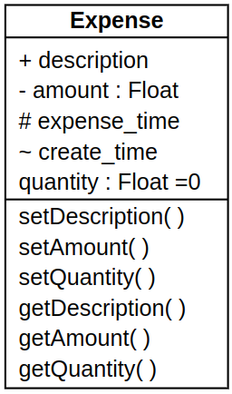
UML - Structural Diagrams - Class Diagram
Class Box : Operations and Methods
Can we add the setters and getters ?
Better not : The aim of UML diagrams is to simplify and convey our understanding to how we would design the system not to care about non-architectural details

Slide 30
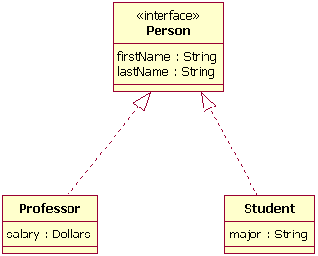
UML - Structural Diagrams - Class Diagram
Class Box : Interface
Is composed of :
Attributes
Operations (Signatures) that need to be implemented inside a class
The Interface is drawn the same way as the class but with annotation word <<interface>> above the interface name
The interface must have at least one class to implement its operation

Slide 31
UML - Structural Diagrams - Class Diagram
Finding the Classes for a Given System
The intuitive way is to read through the software requirements specification and search for nouns that :
Have adjectives or properties or attributes.
Person has the attributes : weight, name, color….
Expense has the attribute : amount, date, description….
May not have adjectives but are associated with other classes.
Country : can be stored as country_name : String, but as all user objects would be using this attribute

Slide 32
UML - Structural Diagrams - Class Diagram
Finding the Classes for a Given System
Brainstorming : via having an open discussion to suggest classes that are implicitly not mentioned during the requirements engineering phase.
Design Patterns : A Pattern is simply a useful group of collaborating classes that provide a solution to a commonly occurring problem ( More to come on design pattern in a separate lecture )

Slide 33
UML - Structural Diagrams - Class Diagram
Case Study 1 : To-do App
List the possible classes for the to-do App, provided the following requirements:
A user can sign up requiring that they provide their full information including address and their email address
The user needs to activate their account via a link they receive in their email box
Users can add To-Do items with a due date, mark it completed and even delete them.
Users can add Sub-To-Do items under a specific item.
To-Do Item can be assigned to a single category and have many labels.
Users can change the sequence/ordering of to-do items shown on their screen.

Slide 34
UML - Structural Diagrams - Class Diagram
Case Study 1 : To-do App
List the possible classes for the to-do App, provided the following requirements:
A user can sign up requiring that they provide their full information including address and their email address
The user needs to activate their account via a link they receive in their email box
Users can add To-Do items with a due date, mark it completed and even delete them.
Users can add Sub-To-Do items under a specific item.
To-Do Item can be assigned to a single category and have many labels.
Users can change the sequence/ordering of to-do items shown on their screen.

Slide 35
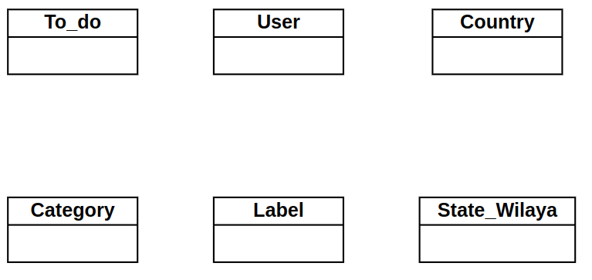
UML - Structural Diagrams - Class Diagram
Case Study 1 : To-do App

Slide 36
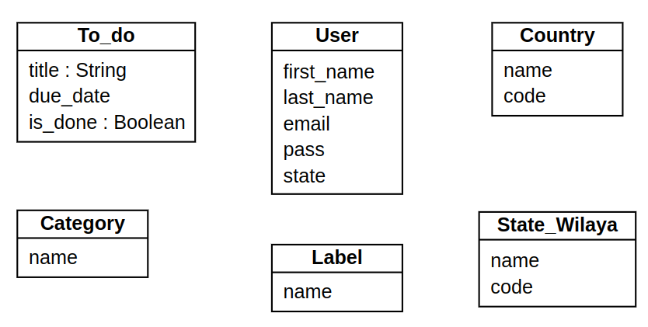
UML - Structural Diagrams - Class Diagram
Case Study 1 : To-do App
Missing any attribute ?

Slide 37
UML - Structural Diagrams - Class Diagram
Case Study 1 : To-do App
Sequence of the item
Missing any attribute ?

Slide 38
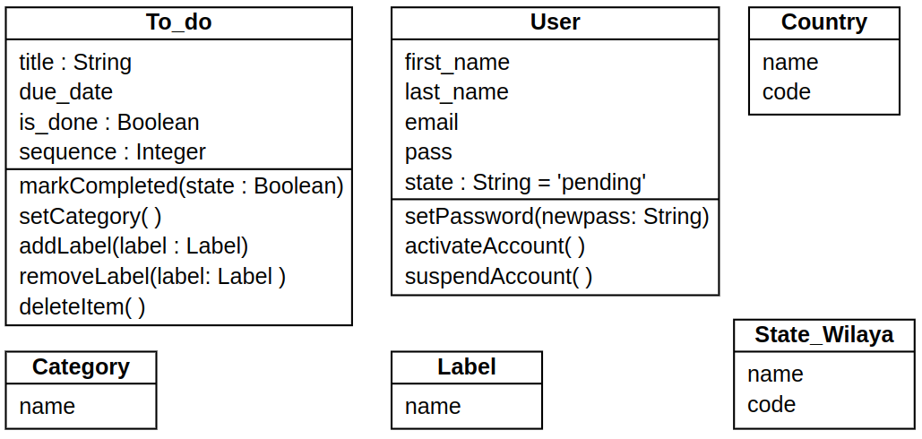
UML - Structural Diagrams - Class Diagram
Case Study 1 : To-do App

Slide 39
UML - Structural Diagrams - Class Diagram
Case Study 2 : Expense Tracker
List the possible classes for the Expense Tracker, provided the following requirements:
A user can sign up requiring that they provide their full information including address and their phone number.
The user would be insert their expense with a single category (or even Subcategory) paying :
In cash ( DZD Currency)
Using their Visa/Mastercard ( In foreign currency)
In Cheque from their bank account
The user can insert their revenue/revenue
The user can see their balance ( How much money they are having now)

Slide 40
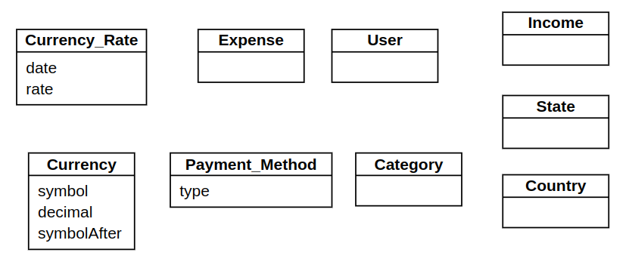
UML - Structural Diagrams - Class Diagram
Case Study 2 : Expense Tracker

Slide 41
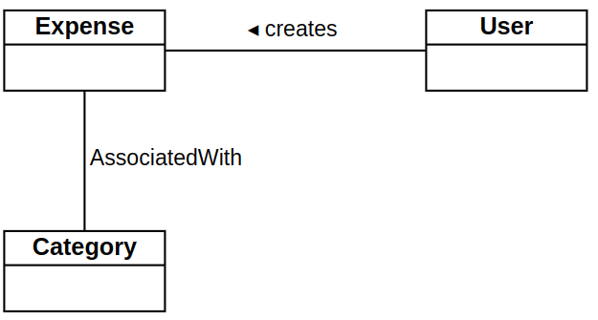
UML - Structural Diagrams - Class Diagram
Relationships : Simple Association
Represents a structural link between two classes.
Drawn as a simple line
Optionally labeled with either the name of the relationship or the roles that the classes play in the relationship
An arrow/Triangle can be added to improve the readability of the association

Slide 42
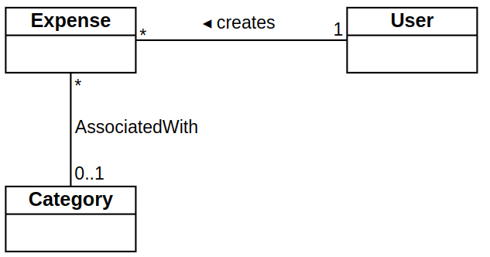
UML - Structural Diagrams - Class Diagram
Relationships : Simple Association
Multiplicity symbols : represent the minimum and maximum times a class instance can be associated with the related class instance

Slide 43
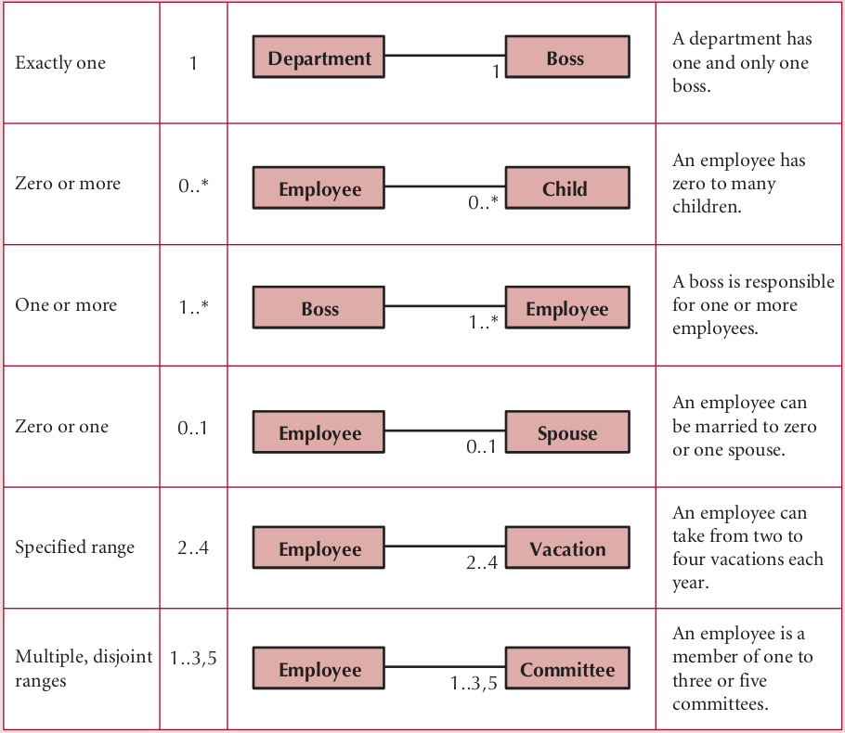
UML - Structural Diagrams - Class Diagram
Relationships : Simple Association
Multiplicity symbols : represent the minimum and maximum times a class instance can be associated with the related class instance

Slide 44
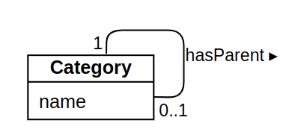
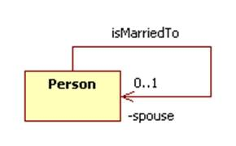
UML - Structural Diagrams - Class Diagram
Relationships : Self-Association
A class can be associated with itself.
Example :
Person can marry a person
Location can be inside a location
(sub)-Category can be placed under a (sub)-Category
If you are programmer, be careful of recursive relationships.

Slide 45
UML - Structural Diagrams - Class Diagram
Relationships : Association Class
It is a class which associates to other classes for the case when the relationship needs to have further attributes or information.
Linked to the association solid line by a dashed line
Association class is drawn as a normal class with attributes and operations.

Slide 46
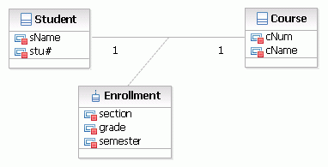
UML - Structural Diagrams - Class Diagram
Relationships : Association Class
Example :
You as a student, you associated directly with the School with no extra data needed? No
The association needs further information like registration year, academic year, status…

Slide 47
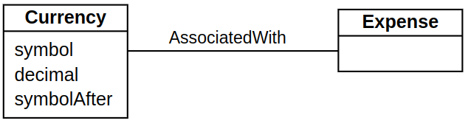
UML - Structural Diagrams - Class Diagram
Relationships : Association Class
Example :
Can we model the expense to the currency as just a simple association ?

Slide 48
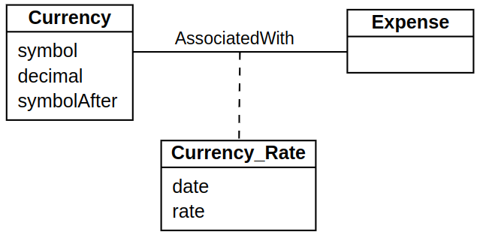
UML - Structural Diagrams - Class Diagram
Relationships : Association Class
Example :
Can we model the expense to the currency as just a simple association ?
We no currency rate + date on top of the association

Slide 49
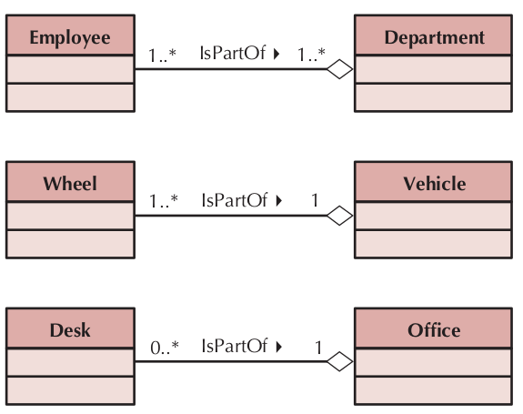
UML - Structural Diagrams - Class Diagram
Relationships : Aggregation
Represents a logical a-part-of relationship between multiple classes or a class and itself.
Logical implies:
Whole Class can be removed without impacting the composing -Classes
Composing-classes can compose different whole classes at the same time ( Multiplicity can be * )

Slide 50
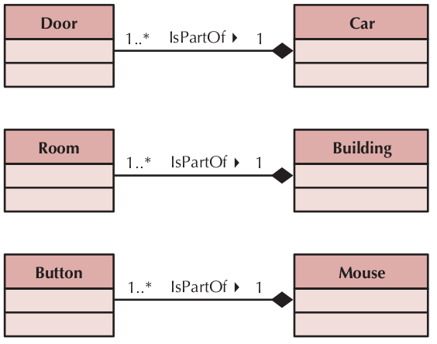
UML - Structural Diagrams - Class Diagram
Relationships : Composition
It is almost the same as Aggregation but a Physical relationship.
If the whole class is removed, the composing-classes are destroyed.
Only one whole class for a given composing class.

Slide 51
UML - Structural Diagrams - Class Diagram
Relationships : Inheritance or Generalization
A generalization association shows that one class (subclass) inherits from another class (superclass):
meaning that the properties and operations of the superclass are also valid for objects of the subclass.
The generalization path is shown with a solid line from the subclass to the superclass and a hollow arrow pointing at the superclass

Slide 52
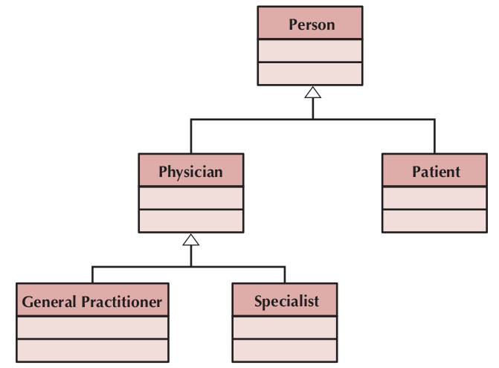
UML - Structural Diagrams - Class Diagram
Relationships : Inheritance or Generalization

Slide 53

UML - Structural Diagrams - Class Diagram
Relationships : Dependencies
is a directed relationship which is used to show that some UML element or a set of elements requires, needs or depends on other model elements for specification or implementation.
If the changes to the definition of one may cause changes to the other (but not the other way around).
Drawn as dashed-line arrow
Class 1 depends on Class 2

Slide 54
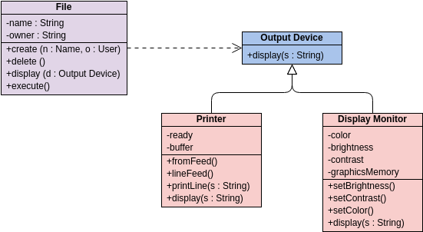
UML - Structural Diagrams - Class Diagram
Relationships : Dependencies

Slide 55
UML - Structural Diagrams - Class Diagram
Relationships : Dependencies

